Slide 1
Web Based Information and Administrative System
Central Chest Clinic – Borella
Group 04

Slide 2
Group Members
W.A.D.I.M. Perera 2104/CS/117 14001179
Dinesh Priyankara 2014/CS/091 14001217
D.D. Athukorala 2014/CS/008 14000083
N.D.G Jayawardana 2014/IS/036 14020361
V.B Nanayakkara 2014/IS/055 14020556
I.D.C.S.J. Ellawala 2014/CS/032 14000326
Web Based Information and Administrative System
Central Chest Clinic – Borella
Group 04
1

Slide 3
Problem Definition
Web Based Information and Administrative System
Central Chest Clinic – Borella
Group 04
2

Slide 4
Introduction
The aim of the project is to produce a comprehensive Web-Based Information and Administrative System for the Chest Clinic at the Medical Research Institute (MRI) situated in Borella.
The Web based information and administrative system for the chest clinic in-Borella will automate the current manual processes that are being currently carried out in the Central Chest Clinic.
Web Based Information and Administrative System
Central Chest Clinic – Borella
Group 04
3

Slide 5
Functional Requirements
Register patient details
Record patients’ medical conditions, details and reports on initial and follow up visit according to a given template.
Forward prescriptions written by doctors to the pharmacy.
Forward required investigations to the investigation sample gathering room, sputum gathering room and the X-ray room.
Statistical representation of past data on illnesses such as the number of new patients diagnosed, number of fatalities in any given period
Web Based Information and Administrative System
Central Chest Clinic – Borella
Group 04
4

Slide 6
Functional Requirements (Cont…)
Retrieve data on patients medical history.
Provide doctors with a viewing facility of all ordered investigations.
Provide information on expected dates for the sputum investigation reports
Maintenance of patients’ medical records
Maintenance of laboratory test results
Pharmacy prescription maintenance
Web Based Information and Administrative System
Central Chest Clinic – Borella
Group 04
5

Slide 7


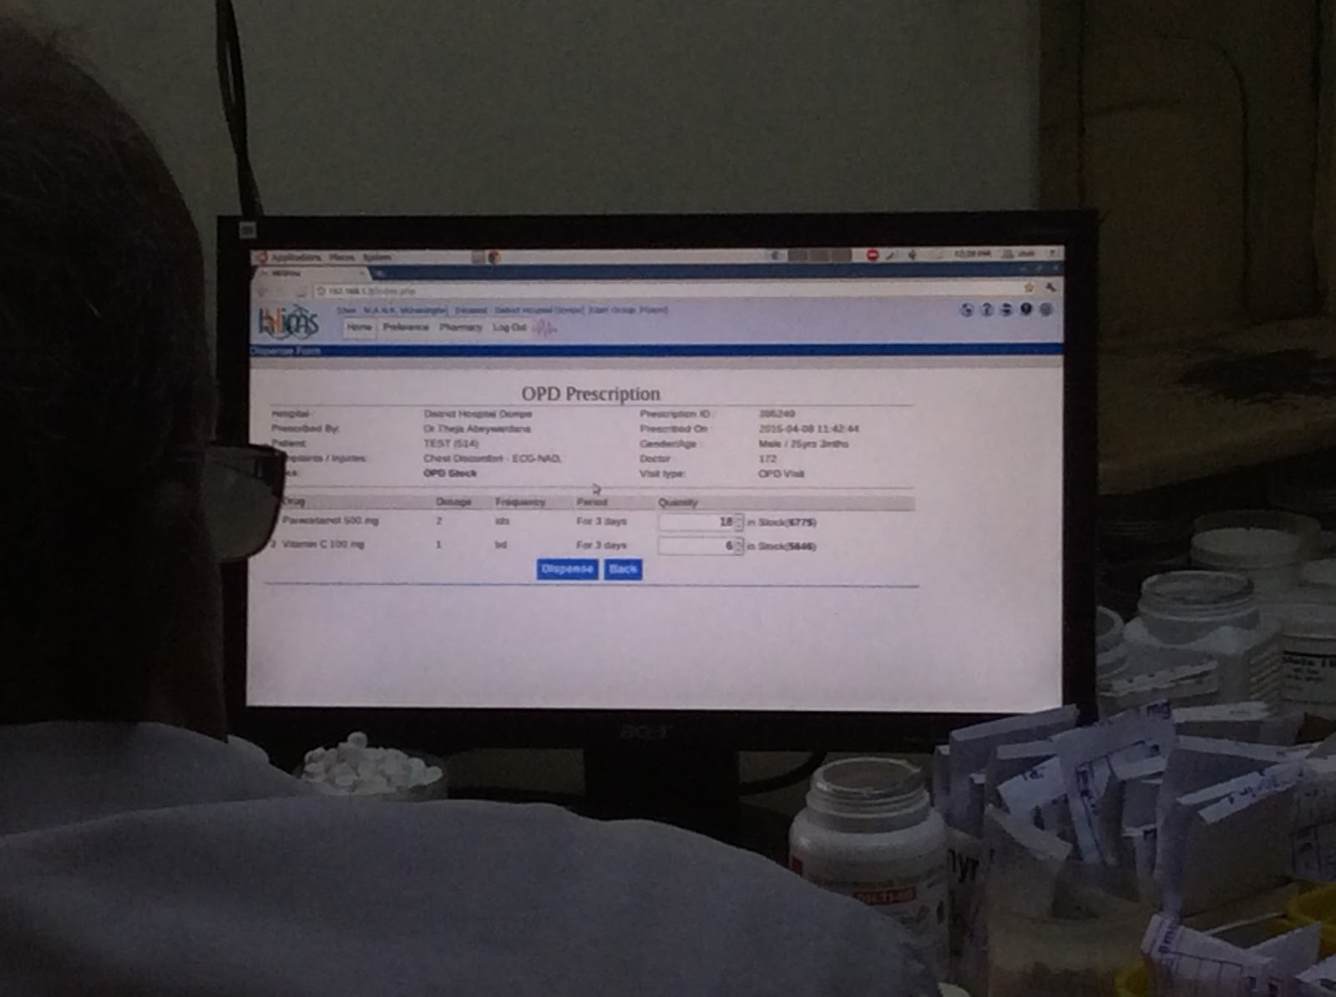
Similar Systems
The system that has been used at Dompe Hospital in Sri Lanka
Web Based Information and Administrative System
Central Chest Clinic – Borella
Group 04
6

Slide 8
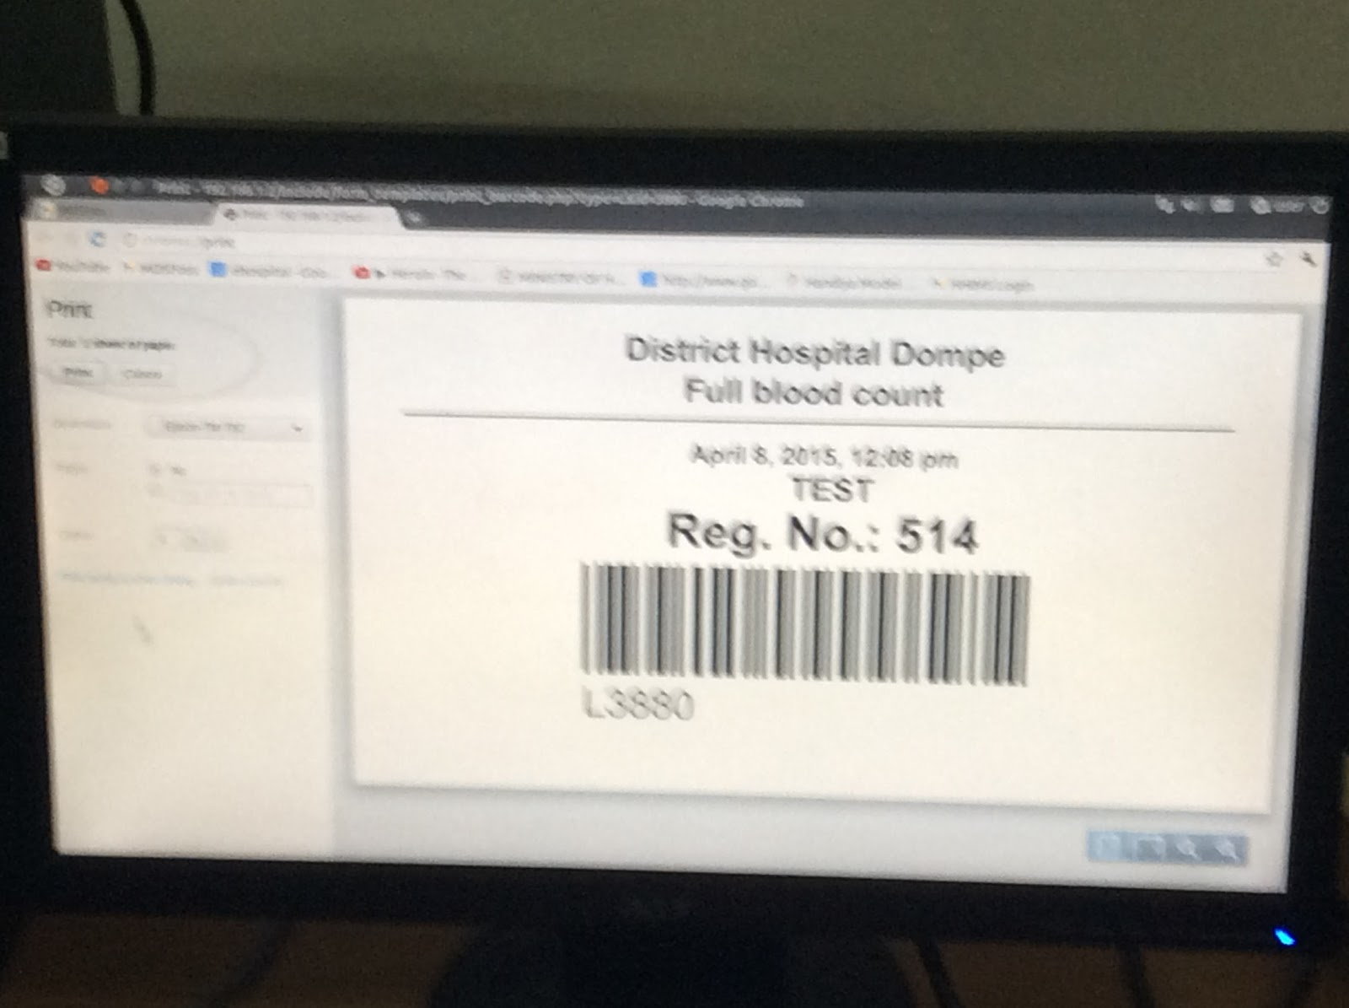

Similar Systems
Web Based Information and Administrative System
Central Chest Clinic – Borella
Group 04
7

Slide 9
Demonstration
Web Based Information and Administrative System
Central Chest Clinic – Borella
Group 04
8

Slide 10
Common Features
Login
Dashboard
User information editing
Common template
Web Based Information and Administrative System
Central Chest Clinic – Borella
Group 04
9

Slide 11

System Users
System Administrator
OPD Doctors
Consultant chest specialists
TB section doctors
Nurses
TB Section Nurses
Bleeding room Nurses
Receptionist
Pharmacists
Laboratory Assistants
X-ray room clerk
Sputum Room clerk
Web Based Information and Administrative System
Central Chest Clinic – Borella
Group 04
10

Slide 12
Administrator
Add new users
View user details
Temporary disable user accounts
Suspend user accounts
Make system backups
Web Based Information and Administrative System
Central Chest Clinic – Borella
Group 04
11

Slide 13
Receptionist
Patient registration
Issuing an identification for the patient
Search patient details
Issuing temporary patient identification
Web Based Information and Administrative System
Central Chest Clinic – Borella
Group 04
12

Slide 14
OPD Doctor
Search patient details
View patient history
View investigation results
Record Observations
Request Investigations
Prescribe medications
Record Observations and clinical impressions
Record treatment plan
Web Based Information and Administrative System
Central Chest Clinic – Borella
Group 04
13

Slide 15
Pharmacist
View prescriptions
Issue medications
Inventory management
Add new stocks
Separate expired stocks
Add new products
View current stocks & products
Web Based Information and Administrative System
Central Chest Clinic – Borella
Group 04
14

Slide 16
Bleeding Room Nurse
View requested investigations
Full Blood Count
Fasting Blood Sugar
Record sample details
Web Based Information and Administrative System
Central Chest Clinic – Borella
Group 04
15

Slide 17
Radiologist
View X-Ray requests
Upload X-Ray images
Web Based Information and Administrative System
Central Chest Clinic – Borella
Group 04
16

Slide 18
Sputum Room Nurse
View requested investigations
Polygenic Culture
AFB Smear
Fungal culture
Record sample details
Web Based Information and Administrative System
Central Chest Clinic – Borella
Group 04
17

Slide 19
Laboratory Assistant
Record FBC investigation results
Record FBS investigation results
Record Sputum investigation results
Web Based Information and Administrative System
Central Chest Clinic – Borella
Group 04
18

Slide 20
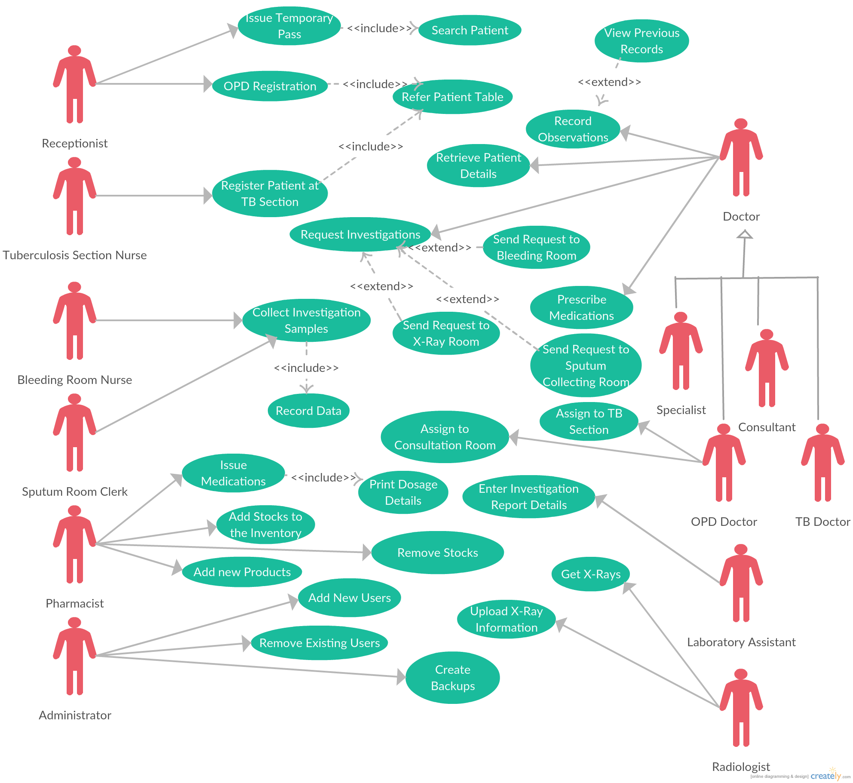

Slide 21
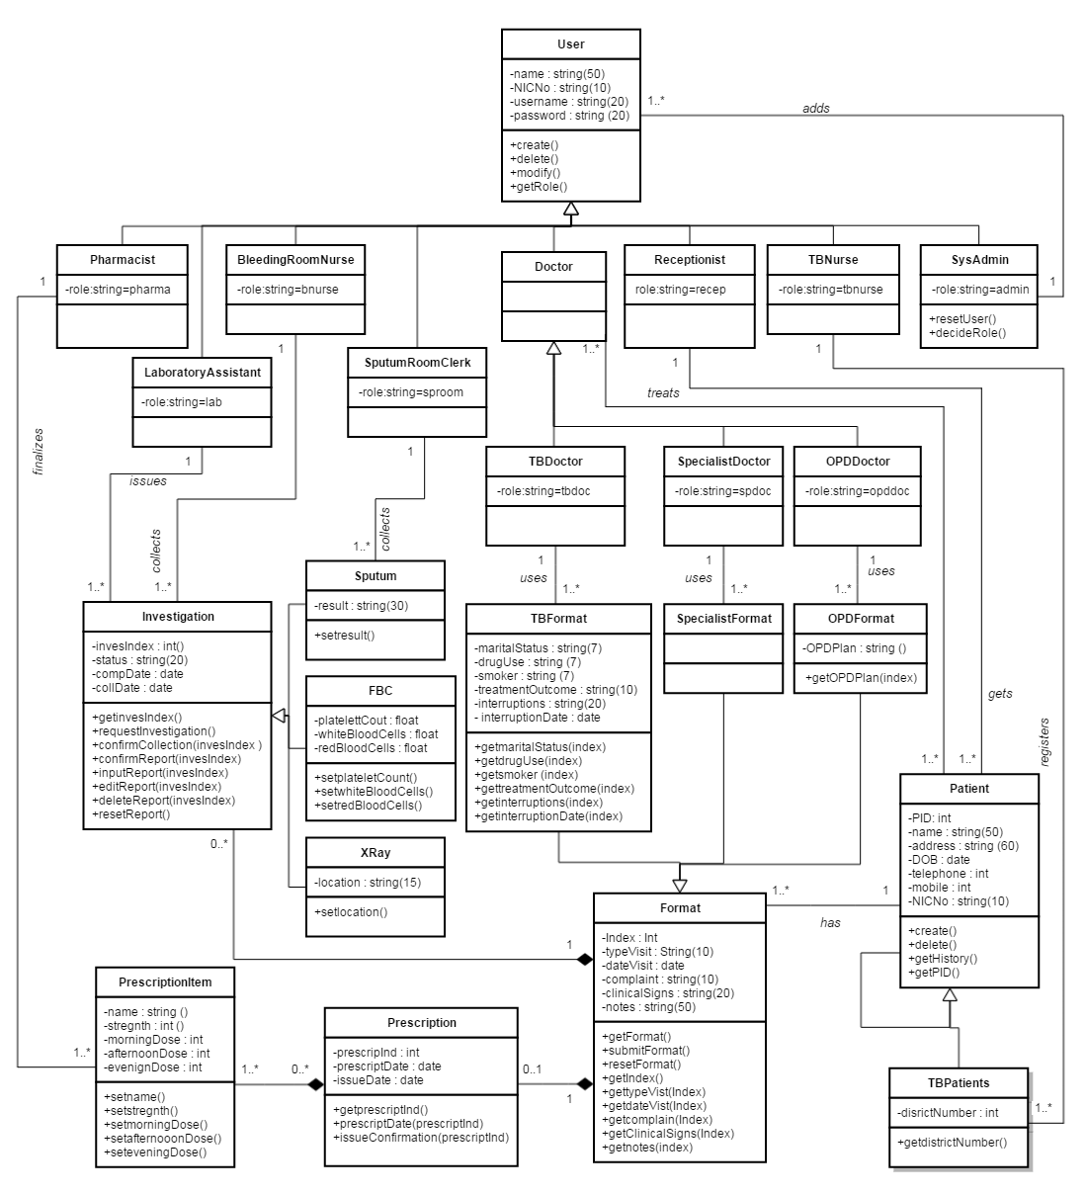

Slide 22
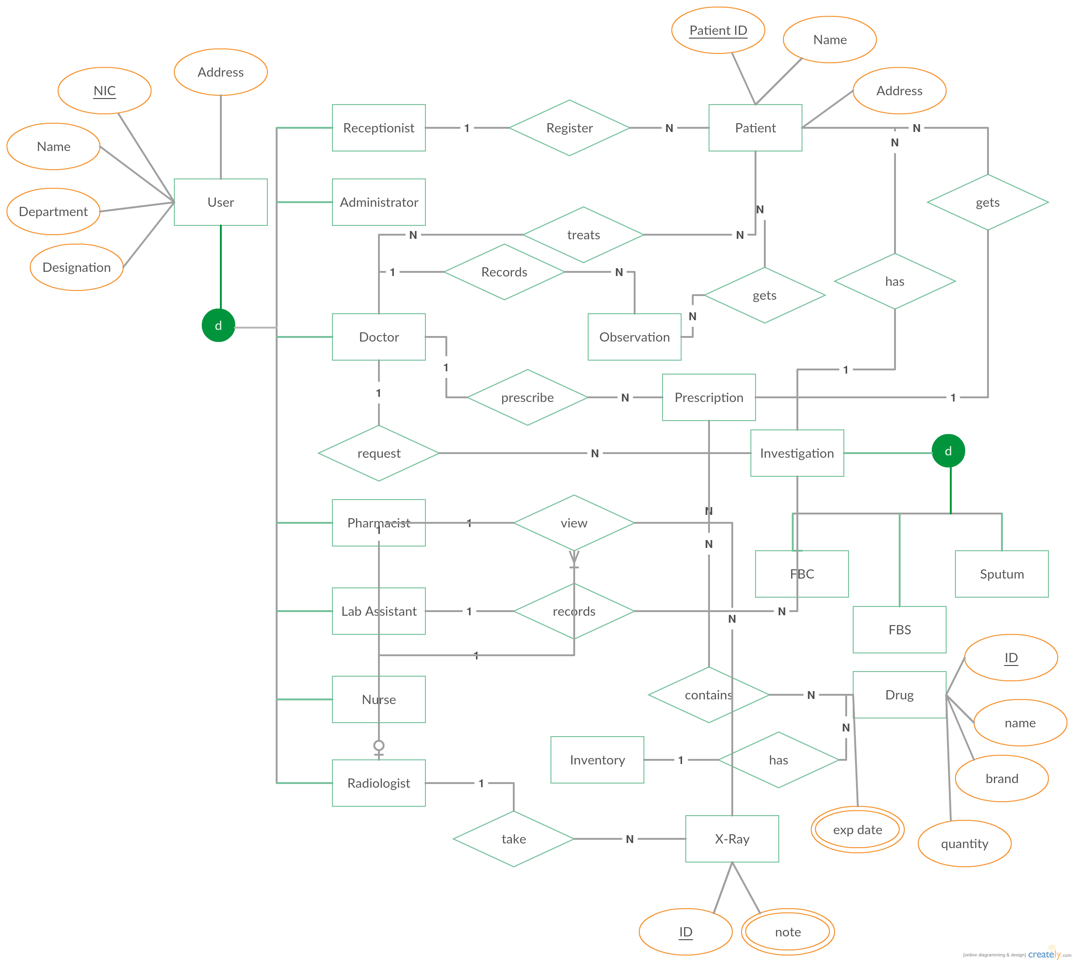

Slide 23
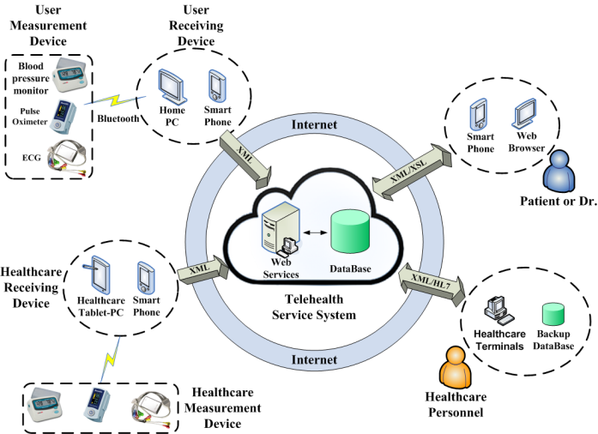
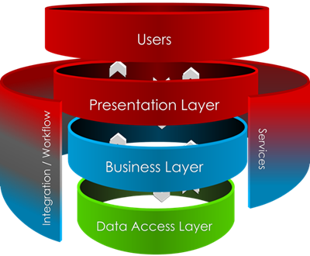
System Architecture
Web Based Information and Administrative System
Central Chest Clinic – Borella
Group 04
22

Slide 24
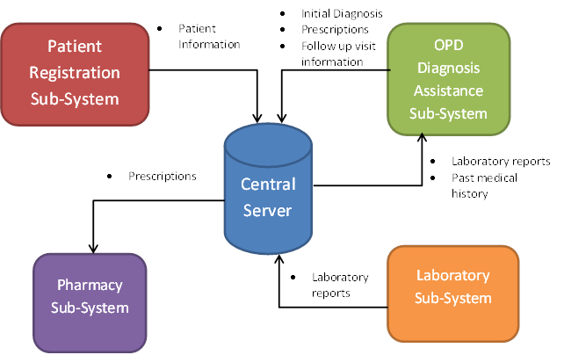
Sub-Components
Web Based Information and Administrative System
Central Chest Clinic – Borella
Group 04
23

Slide 25
Testing Process
Units tests have been carried out on each module to verify functionality
Integration testing has been carried out
Interface testing
System testing completed
Web Based Information and Administrative System
Central Chest Clinic – Borella
Group 04
24

Slide 26
Modules tested
GUI test
Database test
Basic operations add/delete/update/view/search query records in each table
Document Object Model manipulation test
Web Based Information and Administrative System
Central Chest Clinic – Borella
Group 04
25

Slide 27


Front end development
Web Based Information and Administrative System
Central Chest Clinic – Borella
Group 04
26

Slide 28




Back end development
Web Based Information and Administrative System
Central Chest Clinic – Borella
Group 04
27

Slide 29


Deployment
Web Based Information and Administrative System
Central Chest Clinic – Borella
Group 04
28

Slide 30



Test Automation
Web Based Information and Administrative System
Central Chest Clinic – Borella
Group 04
29

Slide 31
Challenges Faced
Team collaboration and knowledge sharing
Different attitude on a single task
Requirements gathering
we had to be specific in some cases such as gathering investigation report, data ranges etc.
Web Based Information and Administrative System
Central Chest Clinic – Borella
Group 04
30

Slide 32
Quality Assurance
Cost benefit analysis on each module developed
Prioritization matrices
Inspections were carried out on each module to verify functionality
Improved user friendliness of GUIs
Data validation
Web Based Information and Administrative System
Central Chest Clinic – Borella
Group 04
31

Slide 33
Best Practices
Version controlling to ensure that radical changes don't affect existing code
A single coding standard to which all programmers adhere
Sharing the code base between all programmers
Commenting to increase code readability and understandability
Code reuse to improve maintainability
Web Based Information and Administrative System
Central Chest Clinic – Borella
Group 04
32

Slide 34
Main Deliverables
Web-based Software System
System Requirement Specification
User Manual
Web Based Information and Administrative System
Central Chest Clinic – Borella
Group 04
33

Slide 35
Feedback
Web Based Information and Administrative System
Central Chest Clinic – Borella
Group 04
34

Slide 36

Thank You
Web Based Information and Administrative System
Central Chest Clinic – Borella
Group 04
35

